Slide 1


DS LAB MINOR PROJECT • TOPIC 9
Customer Satisfaction Report for an E-Commerce Business
Understanding Customer Experiences, Identifying Issues, and Improving Satisfaction
Presented by [Mohammad ismile] • [Raushan ]
Roll Nos. [26BCD10383] • [26BCD10376]
[26BCD6],
Faculty Guide: [Simranjeet Sir]

Slide 2
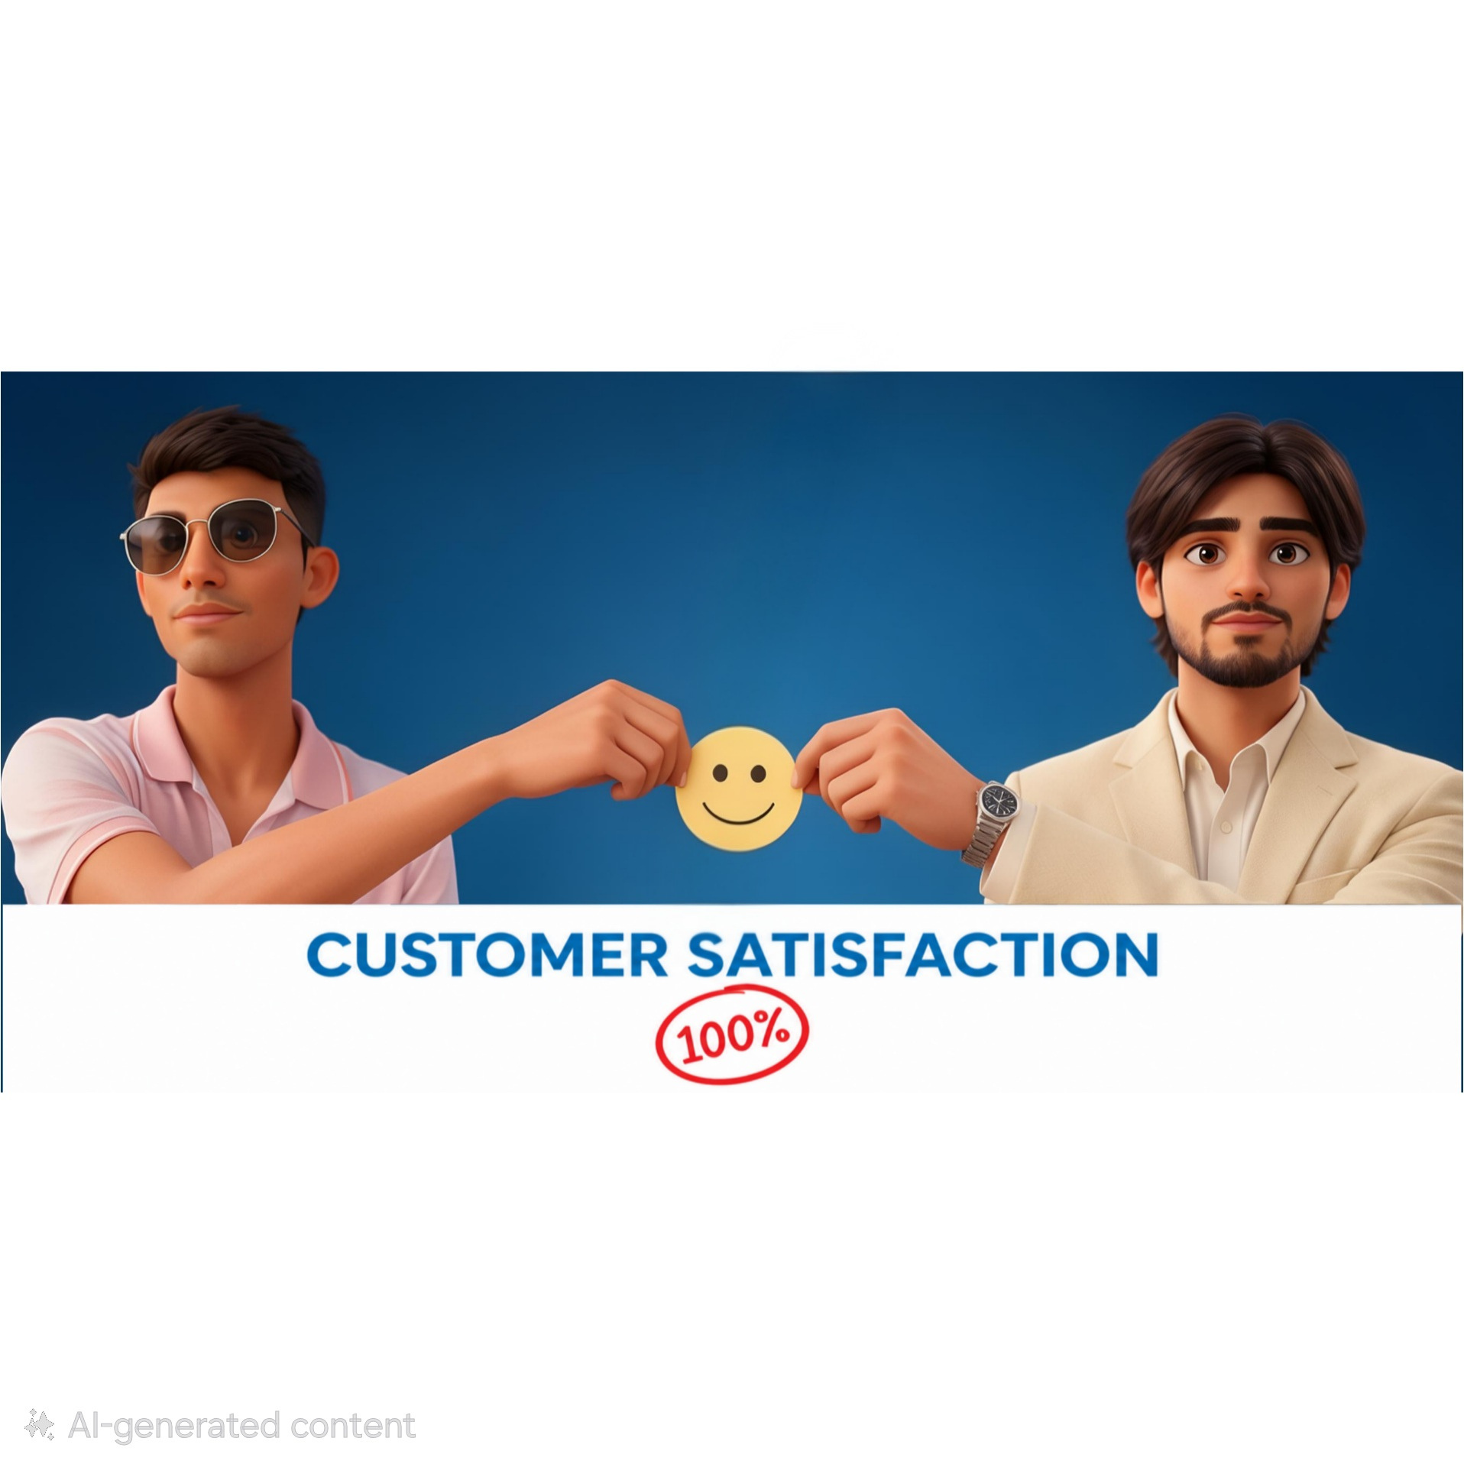
02
Abstract
This project turns customer feedback into a practical roadmap for better e-commerce experiences.
01
02
03
04
Measure
Listen
Discover
Improve
Assess satisfaction across the online shopping experience.
Surface feedback, complaints and recurring pain points.
Identify the drivers that build retention and trust.
Translate findings into focused business action.

Slide 3


03
The online shopping journey
Customers expect quality, convenience and support at every handoff.
Discover
product
Place
order
Make
payment
Track
delivery
Receive
product
Contact
support
Give
feedback
Friction concentrates where promises meet reality: delivery accuracy, product match, refunds and support response.

Slide 4

04
Five objectives, one customer view
01
02
03
Understand satisfaction levels
Identify influential factors
Analyze complaints & pain points
04
05
Map preferences & expectations
Recommend practical improvements

Slide 5
05
Where customer trust breaks
38%
24%
18%
12%
8%
Delayed delivery
Product mismatch
Refund friction
Poor support
Hidden charges
Illustrative pattern: operational failures become trust failures when communication is late or unclear.

Slide 6

06
Technologies implemented
COLLECT
ORGANIZE
VISUALIZE
PRESENT
01
02
03
04
Structured customer survey / feedback form
Project-selected data organization and analysis method
Editable charts and dashboards for the study
PowerPoint presentation for clear communication

Slide 7

07
Project features
1
2
3
Feedback collection
Satisfaction assessment
Pain-point identification
4
5
6
Factor analysis
Feedback visualization
Improvement recommendations

Slide 8
08
From question to recommendation
Identify
problem
Collect
data
Analyze
satisfaction
Propose
changes
Define
objectives
Organize
data
Interpret
findings
Report &
present

Slide 9
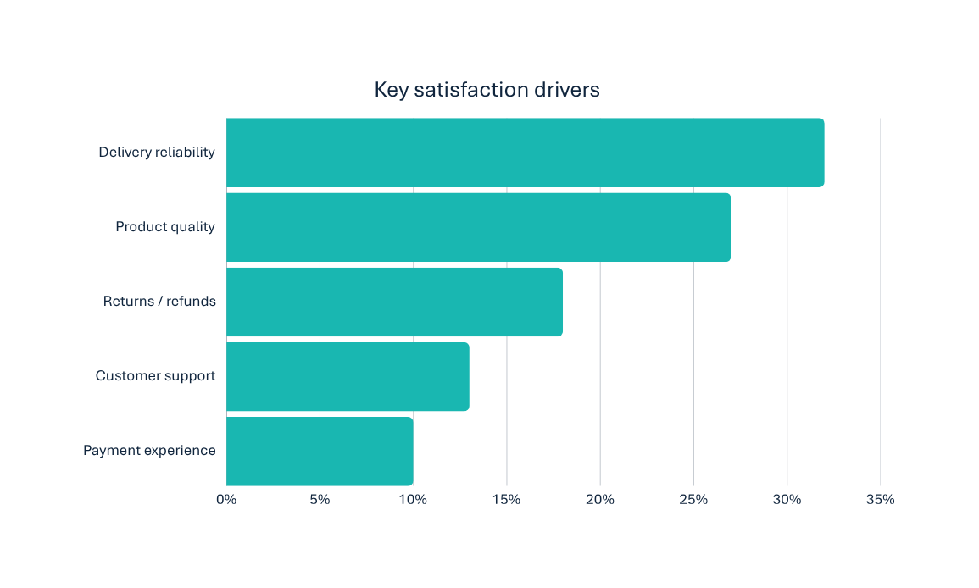
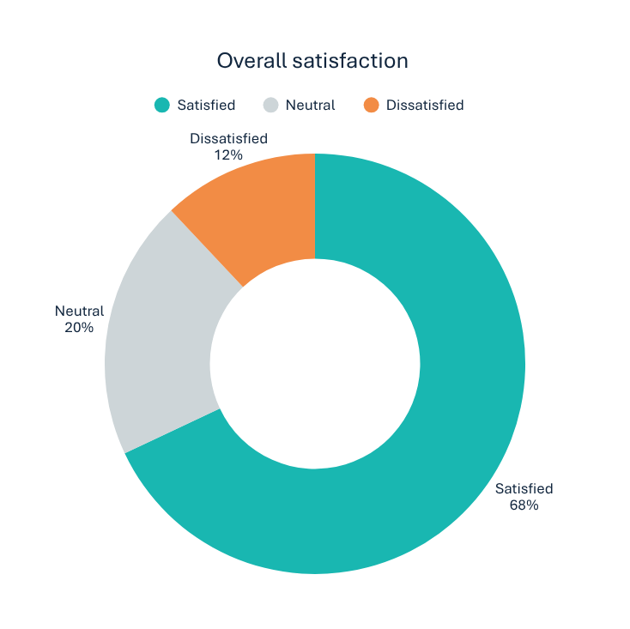
09
Customer satisfaction findings
ILLUSTRATIVE / SAMPLE DATA
3.8 / 5
Delivery reliability and product quality shape nearly 60% of satisfaction.

Slide 10
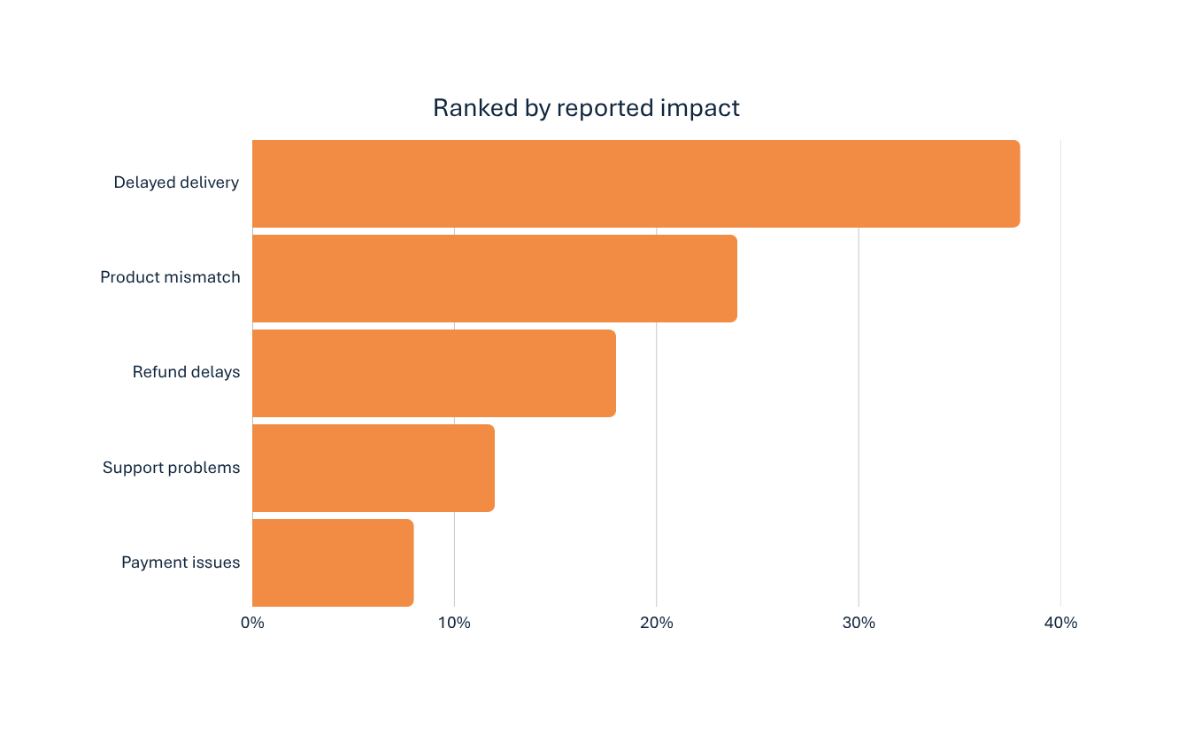
10
Major customer pain points
ILLUSTRATIVE / SAMPLE DATA
#1
Delivery is the priority
Late arrival breaks the promise made at checkout—and weakens trust before support can recover it.

Slide 11
11
Turn friction into loyalty
PROBLEM
PROPOSED SOLUTION
BENEFIT
Which factor would make YOU stop shopping?
Delivery uncertainty
Accurate tracking & ETAs
Trust
Product mismatch
Stronger quality checks
Fewer complaints
Late delivery
Refund friction
Simpler, faster refunds
Repeat purchase
Poor product quality
Slow support
Responsive service
Loyalty
Difficult refund
Unclear expectations
Transparent descriptions
Confidence
Bad customer support
Static learning
Continuous feedback
Sustained gains

Slide 12

Every order is a promise.
Every customer experience decides whether that promise builds trust.
ACHIEVEMENTS
Drivers identified • Pain points ranked • Practical recommendations
LIMITATIONS
Sample dataset • No real company data • Survey-size constraints
FUTURE SCOPE
Larger surveys • Real-time feedback • Sentiment analysis • AI classification • Trend tracking
“A satisfied customer is not just a successful transaction—it is the beginning of long-term trust.”
Thank you • [Student Name 1] & [Student Name 2]

